Slide 1

Securing the Perimeter
Chitransh Mathur
CBS-0403

Slide 2
Overview
XYZ is the premier cryptocurrency exchange. They transact over a billion trades everyday and are considered to be one of the most reliable and secure exchanges in the world. Due to their rapid growth, they've faced challenges in scaling their security posture.
The largest challenge they've faced is with their Perimeter Network Security being secure. The networking team was overburdened with the rapid growth and a majority of the network infrastructure was built insecurely.
Due to a lack of visibility and a lack of proper access control setup on the network, it was inevitable that a breach took place! XYZ was hit with a massive attack in which their network was breached and their internal servers were compromised resulting in over 500 Bitcoin being stolen!
Needing to get the bottom of this breach and resolving their current perimeter issues they've contracted you from SecureCorp, a world renowned cybersecurity consulting firm. Your job is to redesign their network architecture securely and set up a SIEM to monitor against future attacks.

Slide 3
Section 1:
Designing a secure Network Architecture

Slide 4
Network Vulnerabilities
1. Servers have direct Internet access
ISSUE: All Servers (Web Servers, Database, and File Storage Server) are directly connected to the Internet, which is vulnerable to many external attacks. VULNERABILITIES: Every Server is reachable from the internet, which exposes them to external attacks like DDOS, DOS, Unauthorized Access, etc. Database and File Storage Servers should never be connected to the Internet directly, as they contain sensitive data.
2. No Segmentation
ISSUE: A Virtual Network contains a single subnet that includes all five servers. VULNERABILITY: If one server is compromised, an attacker can easily move laterally to another server. Internal Communication between these servers is not restricted or monitored, which can result in the spread of malware or sensitive data being corrupted.

Slide 5
Network Vulnerabilities
3. No Firewall and SIEM Implementation
ISSUE: The current network setup lacks both a firewall for traffic control and a SIEM for centralised monitoring. VULNERABILITY: Without a Firewall, all inbound and outbound traffic is allowed by default. Traffic can include malicious traffic that can compromise the servers. Without SIEM, suspicious activities like unauthorised access, brute-force attempts, and privilege escalation go unnoticed. Many Security Standards (like ISO, NIST, etc) require proper network segmentation and event logging

Slide 6
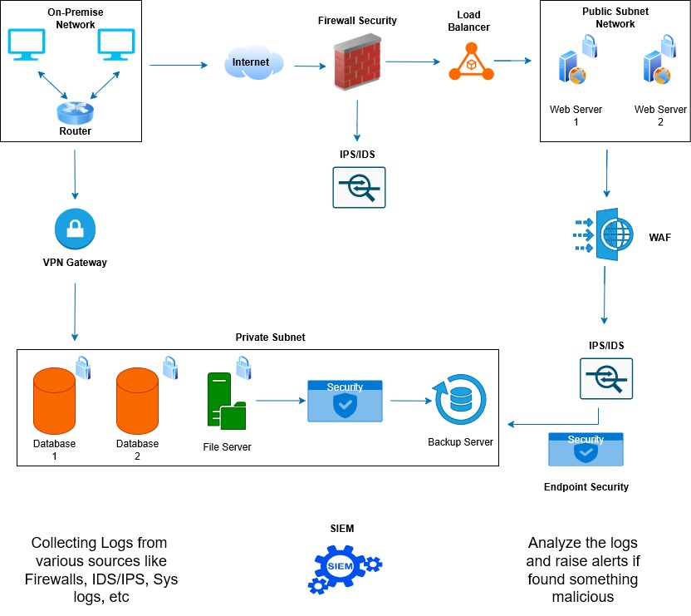
Network Redesign

Slide 7
Convince the Stakeholders
Why do we need to add firewalls to our network?
Firewalls make sure that only safe and intended traffic travels through your network, protecting your data, systems, and users from external and internal threats. Firewalls are a defense in our network security. They act as intelligent gatekeepers that control and monitor all incoming and outgoing traffic. Without firewalls, every server is directly exposed to the Internet, allowing attackers to scan, exploit, or gain unauthorised access to our systems.
What is the benefit of having different areas in our network for web servers and database servers?
Separating networks into different areas is typically known as ‘Network Segmentation’. It prevents attackers from moving freely inside the network if one system is compromised. Database and File Servers are hidden and protected from the Internet. Only Web Servers are in direct contact with the Internet. If a web-server is compromised, an attacker cannot access the database or file-server directly.

Slide 8
Convince the Stakeholders
(CONTINUE)
Traffic between these areas can be filtered out and analysed by the Firewalls, IDS/IPS, and SIEM for any malicious or suspicious activity.
What does a VPN do for our connection to the file storage server?
A Virtual Private Network (VPN) provides a secure connection between our on-premises network and the cloud-based file storage server. Without a VPN, accessing the file server over the Internet would expose sensitive data to interception or unauthorised access. All data is encrypted, preventing eavesdropping or tampering while in transit. Only authorized users and devices can connect — verified through authentication mechanisms.The file server remains private, not exposed to the public Internet. Access can be logged and monitored, helping detect any abnormal activity through the SIEM.

Slide 9
Section 2:
Building a secure Network Architecture in VirtualBox

Slide 10
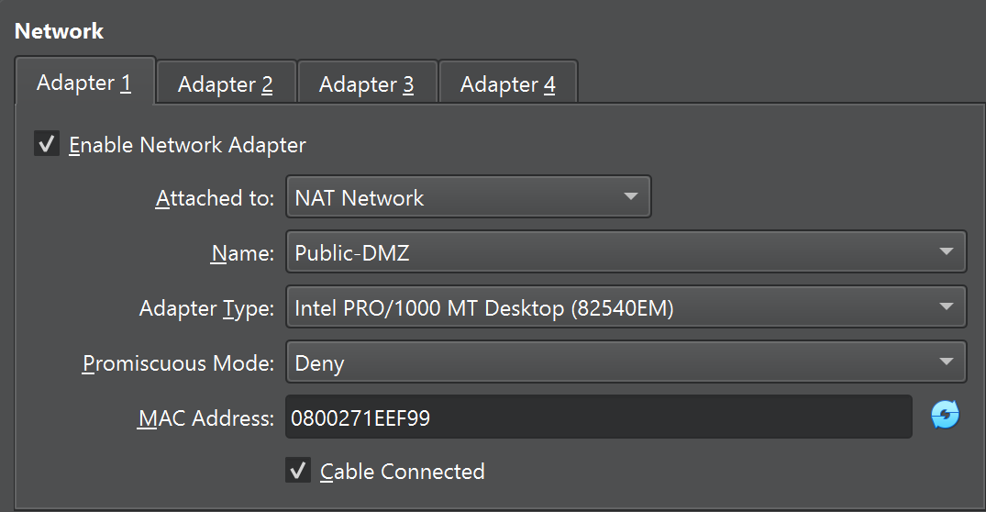
Public Network Subnet
A public-facing network segment that allows controlled access to external or internet resources.
It provides internet connectivity to the VMs (for installing packages, updating repositories, or sending alerts) while still keeping the internal setup isolated from direct internet exposure.
[Add Screenshot here]

Slide 11
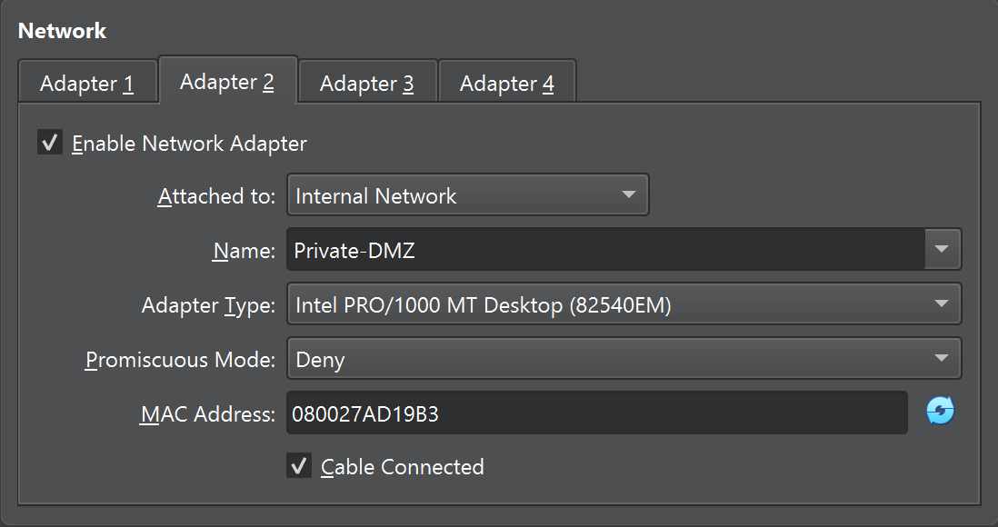
Private Network Subnet
An isolated virtual network within VirtualBox that connects multiple VMs privately without exposing them to the internet.
It enables secure communication between the Gateway, ELK server, and Filebeat (Kali) machines — ensuring that sensitive log data stays within the private monitoring network.
[Add Screenshot here]

Slide 12
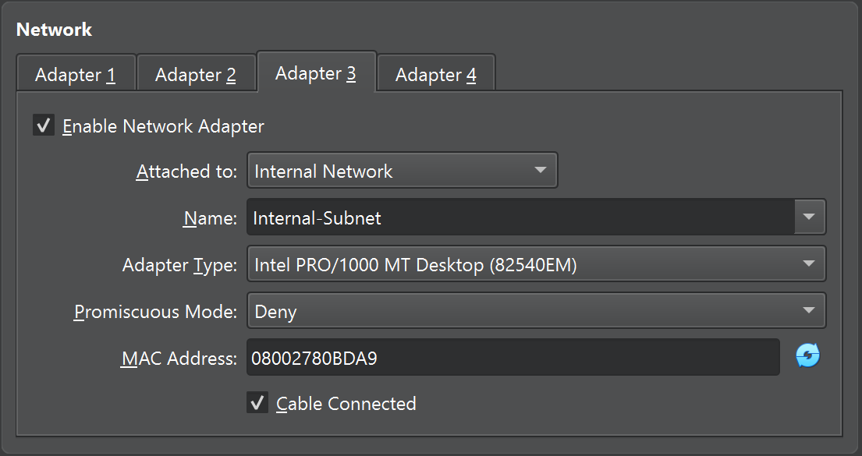
Internal Network Subnet
A smaller subnet inside the private DMZ, used for assigning static IPs (e.g., 192.168.10.x) to VMs for stable internal routing.
It provides a fixed addressing scheme so each component (Gateway, ELK, Filebeat) can communicate reliably without IP conflicts or DHCP dependency.
[Add Screenshot here]

Slide 13
Section 3:
Continuous Monitoring with a SIEM

Slide 14
Understanding SIEM Benefits
1. Centralized Security Monitoring
SIEM collects and consolidates logs from servers, firewalls, routers, switches, applications, and endpoints into a single platform. This centralized view eliminates data silos, allowing security teams to monitor the entire network from one dashboard. Real-time visibility ensures that no suspicious activity goes unnoticed, providing a comprehensive understanding of the network’s security posture. Centralization also simplifies management, troubleshooting, and correlation of events across distributed systems.
2. Real-Time Threat Detection and Alerts
SIEM continuously analyzes incoming log data using correlation rules, pattern recognition, and behavioral analytics to detect abnormal activities. It can automatically identify indicators of compromise (IoCs), such as brute-force login attempts, port scanning, or unauthorized access attempts. When such behavior is detected, SIEM generates real-time alerts to notify administrators for immediate action. Early detection minimizes the time attackers have within the network, significantly reducing potential damage or data loss.

Slide 15
Understanding SIEM Benefits
3. Faster Incident Response and Forensic Investigation
SIEM tools provide contextual information about incidents by correlating related events from multiple sources. Analysts can trace the full path of an attack — from initial compromise to affected assets — within seconds. This accelerates containment and remediation, reducing downtime and operational disruption. The centralized log storage also serves as a valuable forensic database for post-incident investigations, enabling root cause analysis and future prevention.

Slide 16
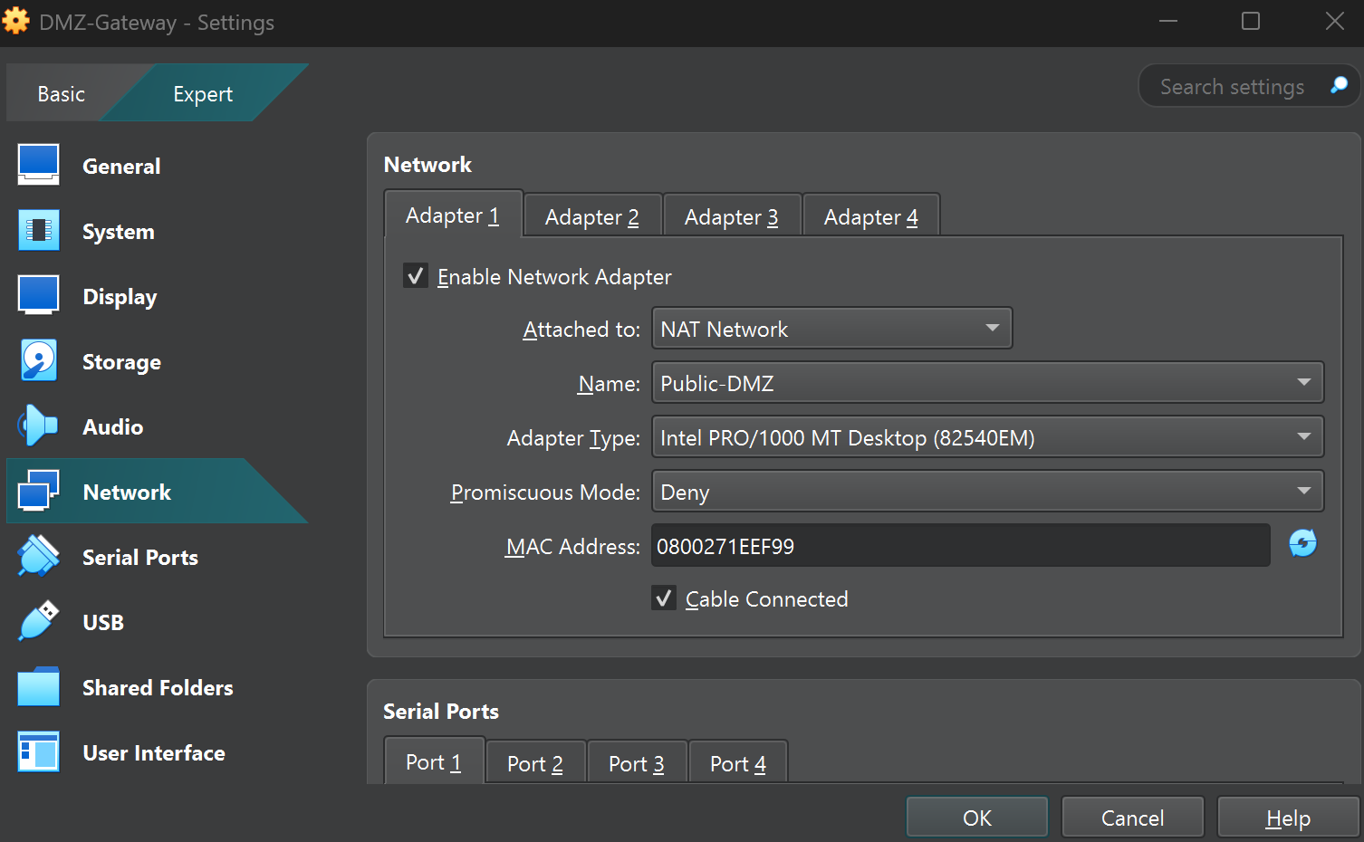
Gateway Virtual Machine
A dual-homed virtual machine with two network interfaces — one connected to the Public DMZ (internet) and the other to the Private DMZ (internal network).
It acts as a bridge and firewall, enabling internet access for internal VMs and controlling traffic flow between the internal and external networks. It ensures isolation and controlled communication.

Slide 17
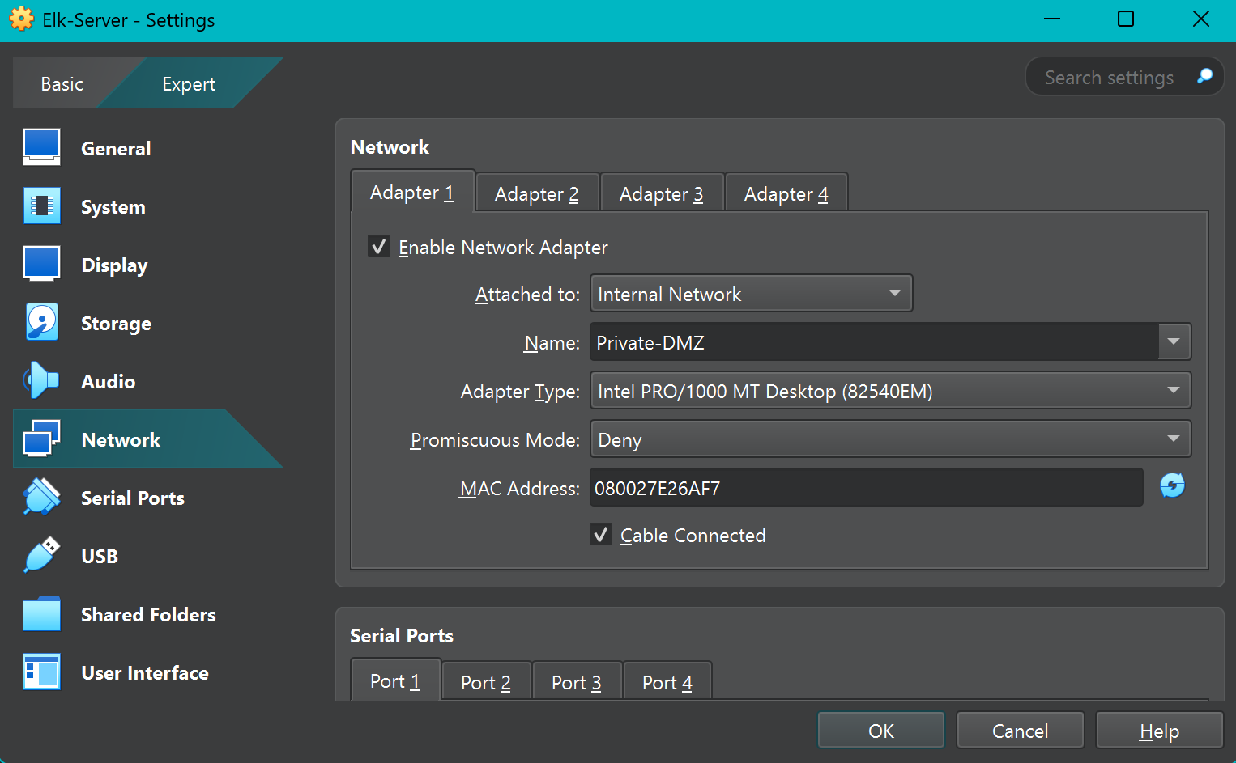
ELK-Server Virtual Machine
A virtual machine hosting the Elasticsearch, Logstash (optional), and Kibana services — collectively forming the SIEM (Security Information and Event Management) platform.
It stores, indexes, and visualizes the logs sent from Filebeat. This VM performs centralized log analysis, threat detection, and visualization through Kibana dashboards.

Slide 18
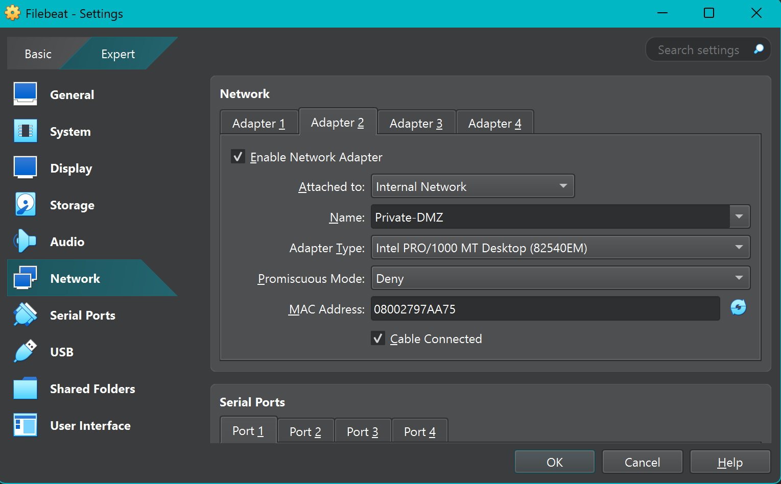
Filebeat Virtual Machine
A client VM (running Kali Linux) is configured with Filebeat, a lightweight log shipper that collects and forwards logs to Elasticsearch.
It simulates a monitored endpoint in the network — collecting system logs and securely forwarding them to the ELK server for analysis and alerting.

Slide 19
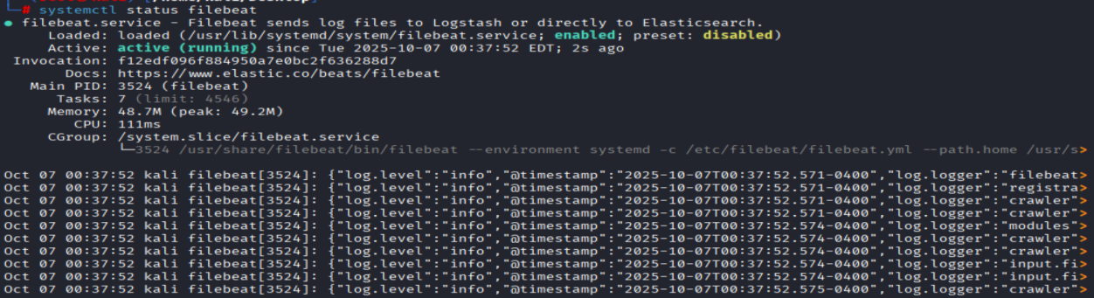
Filebeat Service on the Web Server
Screenshot of the Filebeat service on the web server (command: ‘systemctl status filebeat’)
.
[Add Screenshot here]

Slide 20
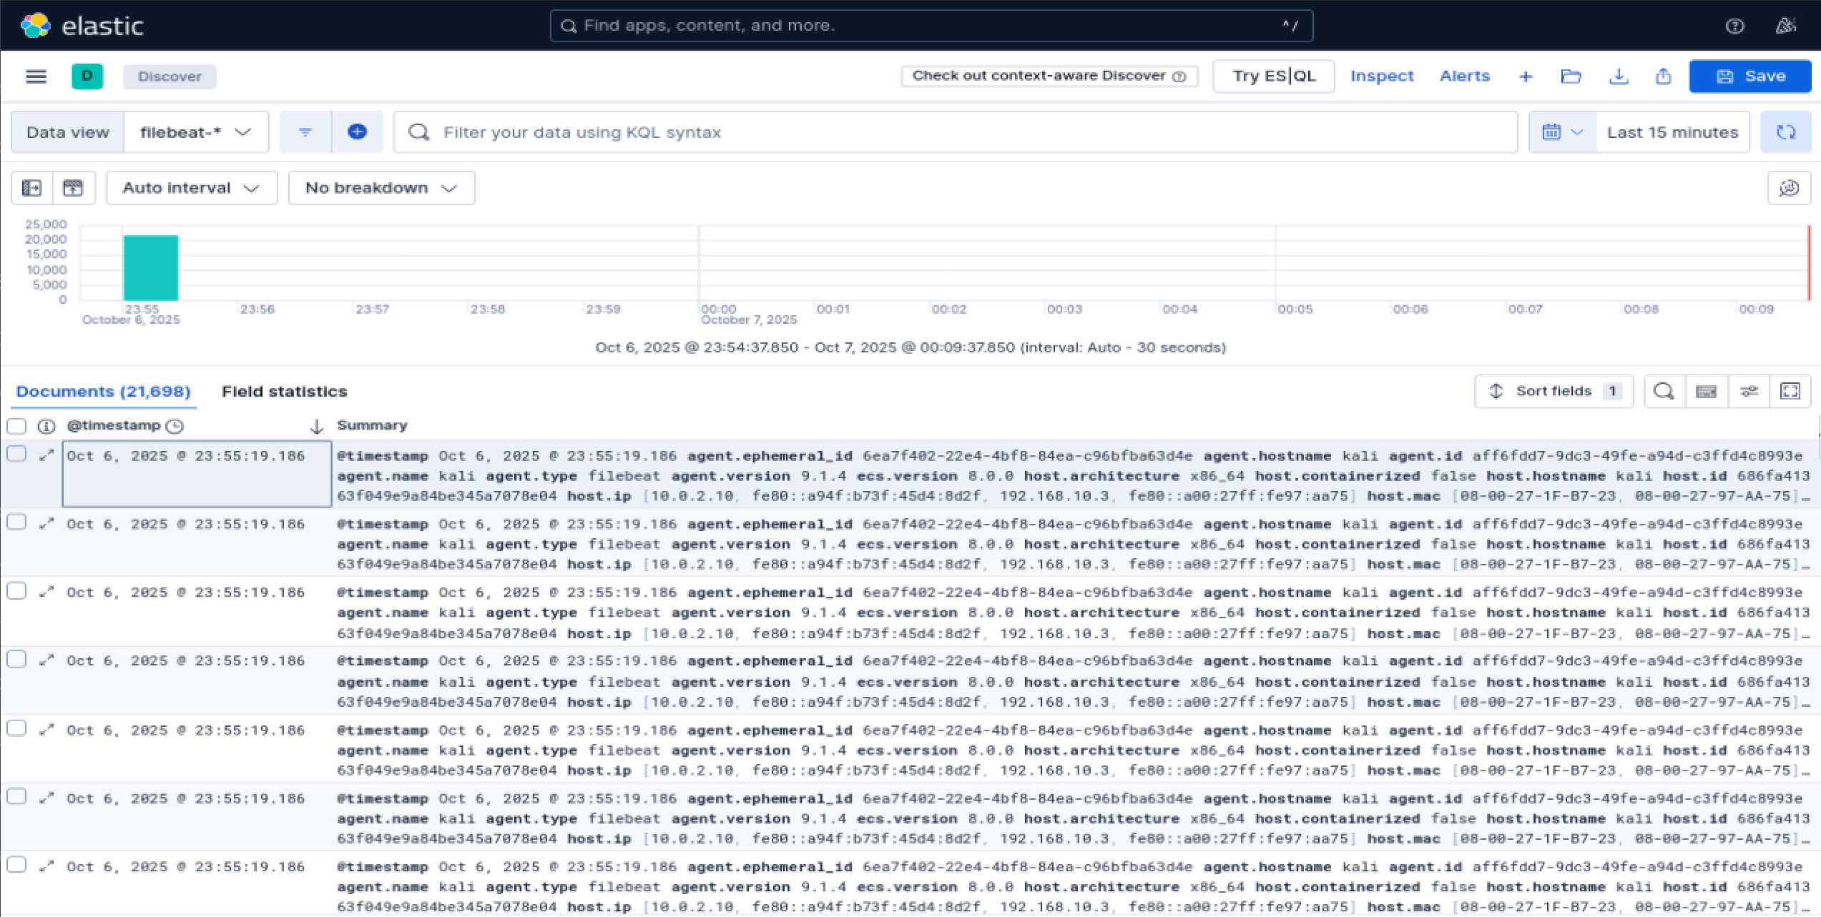
Setup Monitoring
Screenshot showing that Kibana receives logs from the Filebeat host (SIEM/Hosts/Filebeat-VM)
[Add Screenshot here]

Slide 21
Section 4:
Zero Trust

Slide 22
Zero Trust Comparison
1.Consideration of All Resources
Zero Trust Approach: Zero Trust eliminates the assumption of inherent trust within the network. It treats every user, device, application, and system as a potential attack vector, whether it resides inside or outside the organization’s perimeter. Every access request is evaluated based on multiple factors—identity, device health, role, location, and risk level—before permission is granted. Even internal resources must be authenticated and authorized for every interaction. | Traditional Approach: Traditional security models are perimeter-based, relying on the concept of a secure internal network protected by firewalls, intrusion prevention systems, and gateways. Once a user or device gains access to the internal network, it is typically considered trustworthy. This approach assumes that threats exist primarily outside the network perimeter. As a result, internal devices, servers, and users often communicate freely with minimal verification.
Benefits of Zero Trust: Prevents lateral movement by attackers inside the network. Reduces the risk from insider threats and compromised accounts. Improves visibility and control over all resources and interactions. Ensures consistent policy enforcement across hybrid and cloud environments.
2.Continuous Monitoring and Dynamic Authentication
Zero Trust Approach: Zero Trust emphasizes continuous monitoring and dynamic authentication. User behavior, device posture, network activity, and application integrity are continuously analyzed in real time. Access permissions are dynamically adjusted based on contextual risk factors, such as unusual login locations, time of access, or changes in device security posture. If suspicious activity is detected, access can be immediately revoked, and security teams are alerted. | Traditional Approach: In traditional security systems, authentication usually happens once, during login. After that, the session remains valid, even if the user’s device becomes compromised. Monitoring is largely reactive; logs are analysed only after suspicious behaviour or incidents occur

Slide 23
Zero Trust Comparison
Benefits of Zero Trust: Real-Time Threat Detection: Enables continuous assessment of user and device behavior, identifying anomalies the moment they occur. Reduced Insider Threats: Constant validation makes it harder for compromised internal accounts or malicious insiders to exploit their privileges. Adaptive Security Controls: Automatically adjusts access permissions based on changing risk levels (e.g., unusual login location or device compromise). Enhanced Incident Response: Provides security teams with real-time data and alerts to act quickly and contain threats. Improved Visibility and Compliance: Generates detailed activity logs and analytics for auditing, regulatory compliance, and forensic investigations.
3. Secured Communication
Zero Trust Approach: Zero Trust mandates that all communications—internal and external—be encrypted and verified. Each data transfer must occur over a secure channel, ensuring confidentiality and integrity across all network layers. | Traditional Approach: Traditional architectures typically encrypt traffic only when it crosses the perimeter (e.g., using HTTPS over the internet). Internal communications are often left unencrypted, assuming the internal environment is trusted. This makes internal data susceptible to interception or tampering if an attacker gains access.
Benefits of Zero Trust: Guarantees end-to-end encryption for all data transfers, both internal and external. Prevents data interception and tampering by ensuring all communication occurs over trusted, encrypted channels. Protects sensitive organizational data in motion, maintaining confidentiality and integrity. Strengthens compliance with regulatory and industry standards such as GDPR, HIPAA, and ISO 27001. Enables secure integration between cloud services, remote users, and internal systems. Reduces the risk of man-in-the-middle attacks by verifying both communicating parties.

Slide 24
Zero Trust Model
Device Agent and Gateway
For XYZ, the Device Agent & Gateway model is the definitive choice, mandating continuous verification of both user identity and endpoint security posture. A traditional VPN connects the "On-Premise Network" to the "Private Subnet," effectively making the remote user's computer part of that trusted network. If that on-premise computer gets malware, it can easily attack the databases because the network trusts it. The agent and gateway model eliminates this broad network access. When an administrator on-premise tries to connect, the gateway intercepts the request. It verifies the user's identity and the health of their computer via the agent. Access is then only granted to the specific database or server they are authorized to manage, for that specific session. The rest of the private subnet remains invisible and inaccessible. Dual Verification: This model's core strength is its requirement to verify both the user's identity and the device's security health. Access is only granted if both are compliant. Secures the Modern Workforce: It is perfectly suited for a hybrid network, creating a consistent security perimeter that protects every user and device, whether they are in the office, at home, or travelling.

